Slide 2
Brushing the Surface of an Obsession

Slide 4
Part One
Why a Corolla?

Slide 5
Project Corolla
brushing the surface of an obsession
So what is so special about this Corolla?
Last rear wheel drive Corolla produced
First mass-produced 4-valve per cylinder engine
Advanced (at the time) multiport fuel injection
Four-wheel disc brakes
Very lightweight and fun to drive

Slide 6
Project Corolla
brushing the surface of an obsession
Why does it mean so much to me?
Uncle bought car brand new in 1986
Large sentimental value attached
Always wanted car since childhood
Six years of restoration and modification

Slide 7
Project Corolla
brushing the surface of an obsession
What are the goals of the project?
Restore and repair rust and wear damage
Modernize the vehicle
Install missing features and options
Increase vehicle performance and handling
Stay true to the original vehicle design

Slide 8
Project Corolla
brushing the surface of an obsession
What are the goals of the project?
Restore and repair rust and wear damage
Modernize the vehicle
Install missing features and options
Increase vehicle performance and handling
Stay true to the original vehicle design

Slide 9
Part Two
Twenty-Four Years Ago

Slide 10
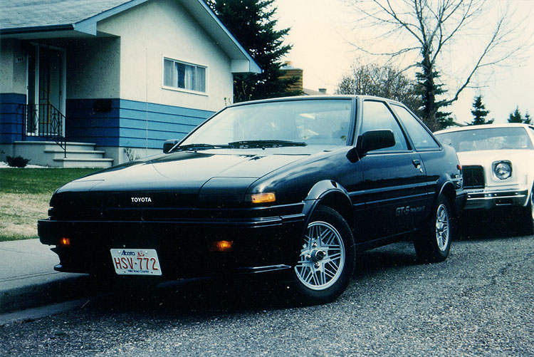
May 2, 1986: Delivery Day

Slide 11
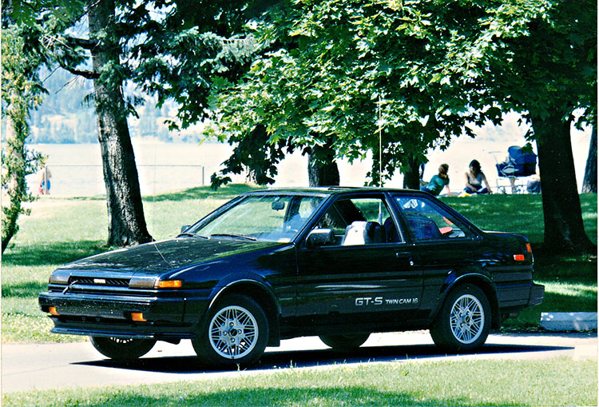
1988: Vacation in Kelowna

Slide 12
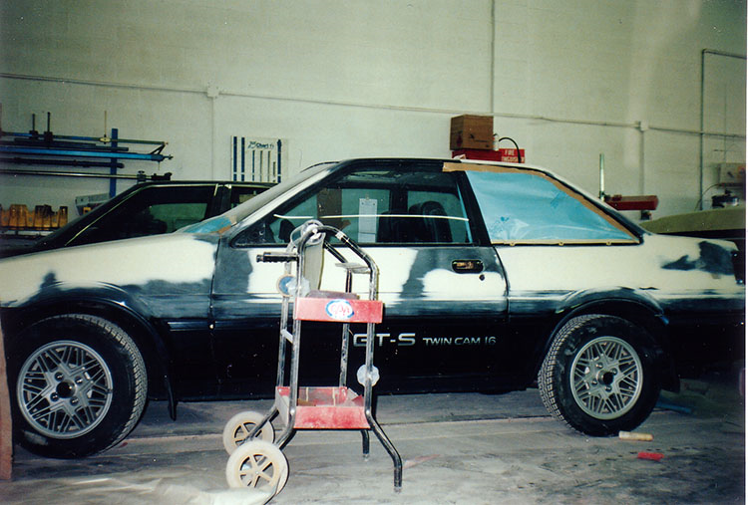
1992: Hail damages the car, repainted

Slide 13
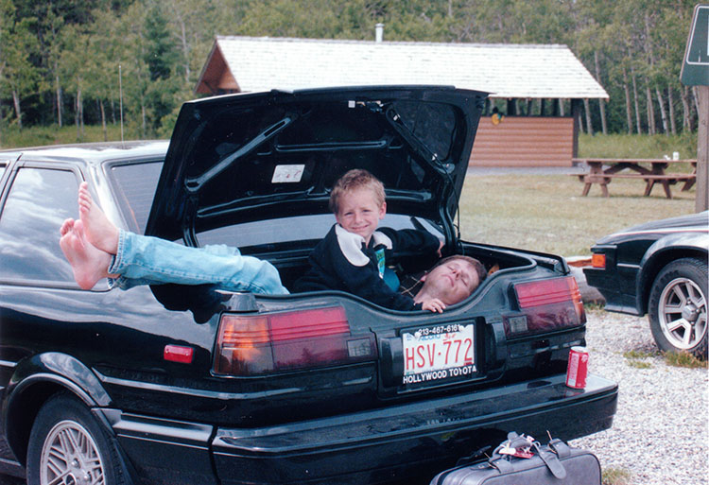
1992: Myself and my uncle relax in Banff

Slide 14
Part Three
Fast Forward

Slide 15
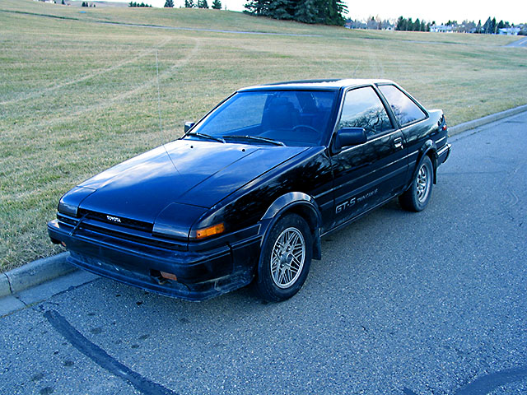
December, 2004: Second Delivery Day

Slide 16
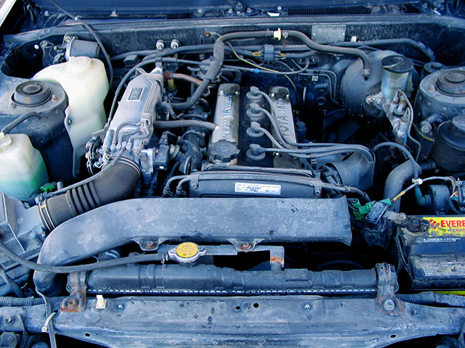
Before: A bit of dirt and grease to be cleaned

Slide 17
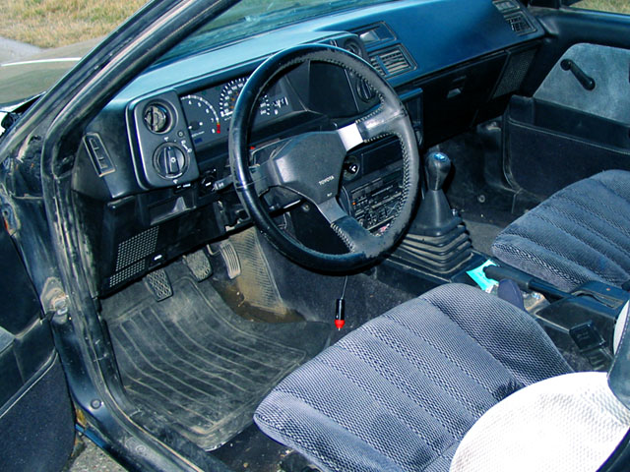
Before: Decent condition, but dirty

Slide 18
Part Four
So What’s Wrong?

Slide 19
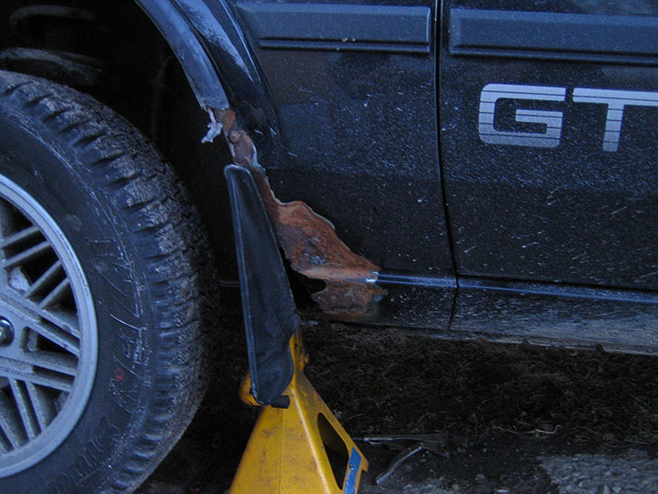
Rust is by far the number one concern

Slide 20
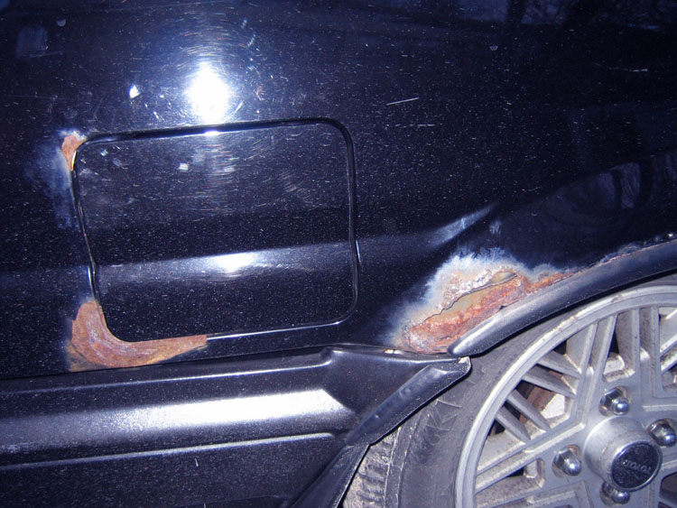
Quarter panel rust is extremely costly

Slide 21
Part Five
Pictures Say a Thousand Words

Slide 22
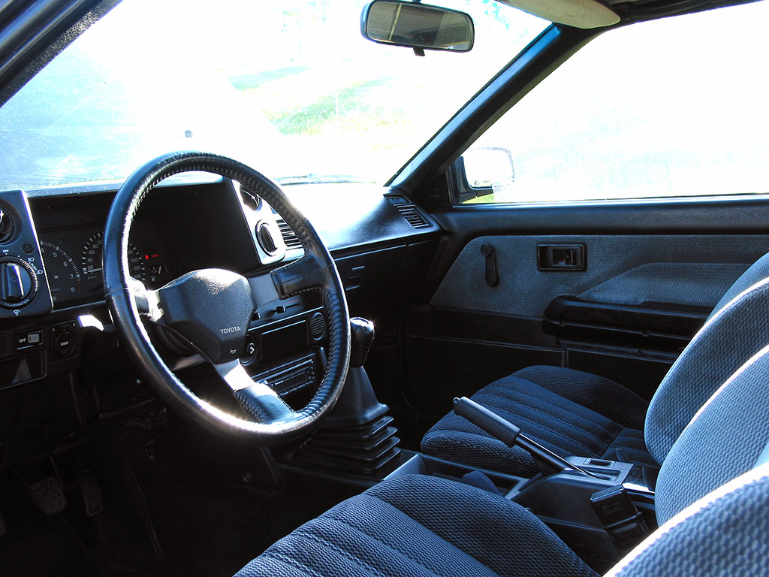
Some things can be cleaned

Slide 23
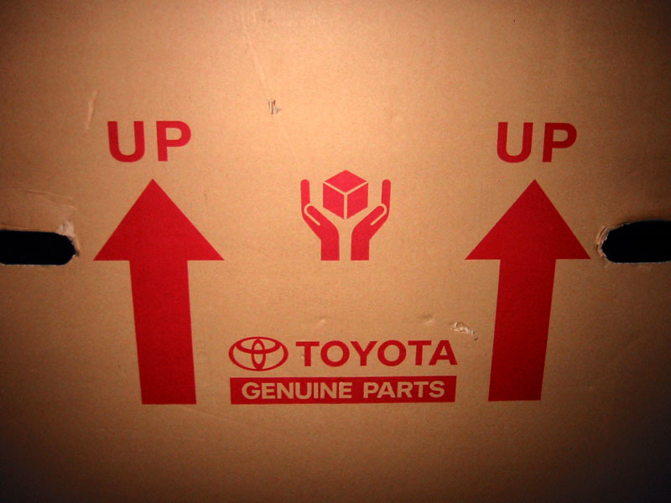
Others require replacement

Slide 24
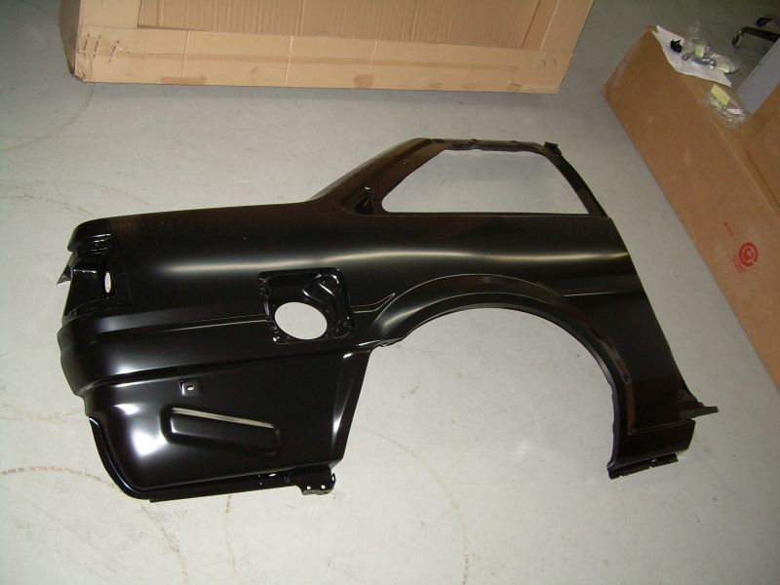
New quarter panels

Slide 25
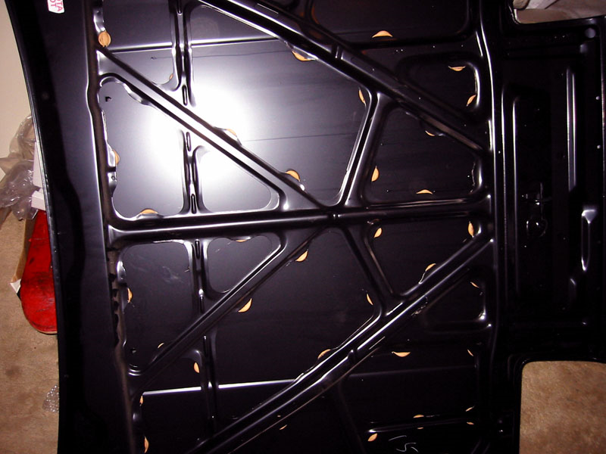
New hood panel

Slide 26
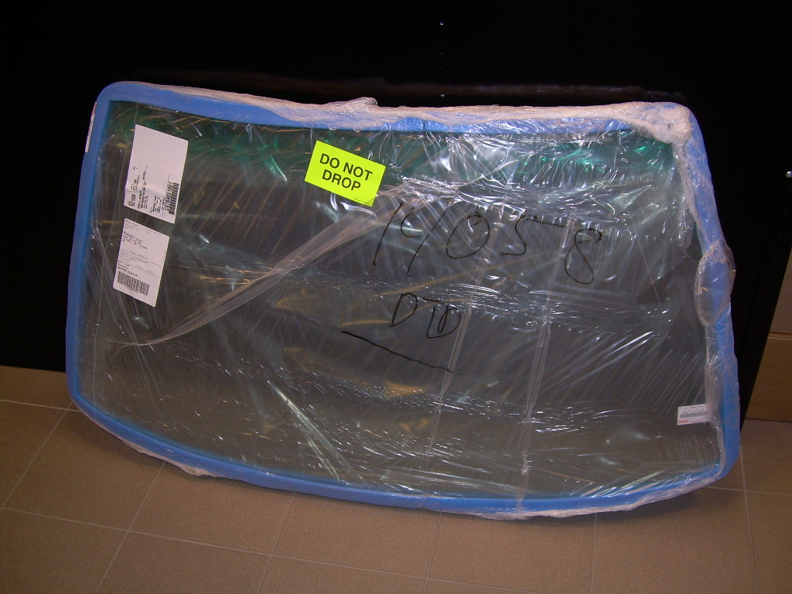
New factory windshield

Slide 27
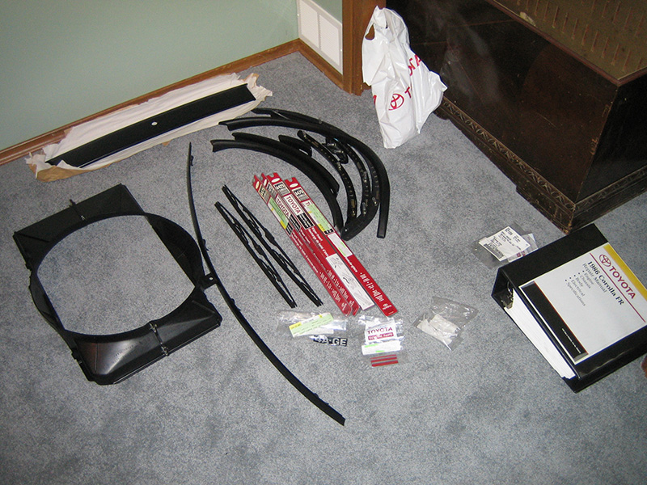
New trim and wipers

Slide 28
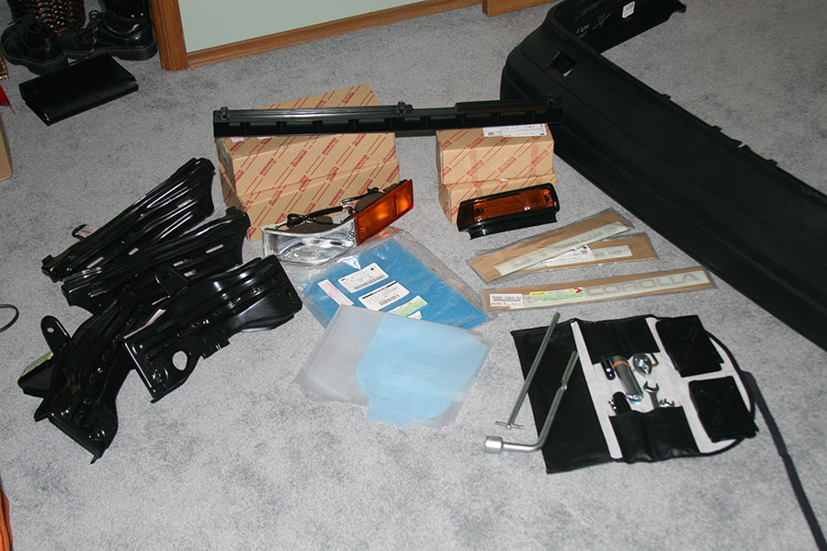
New lights, bumpers, and decals

Slide 29
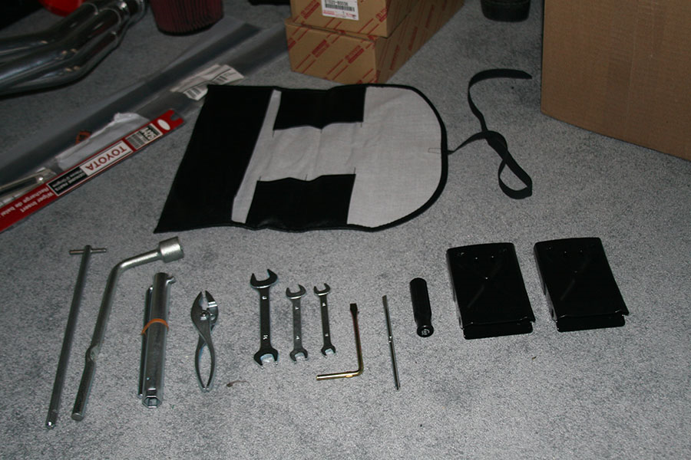
New roadside tool kit

Slide 30
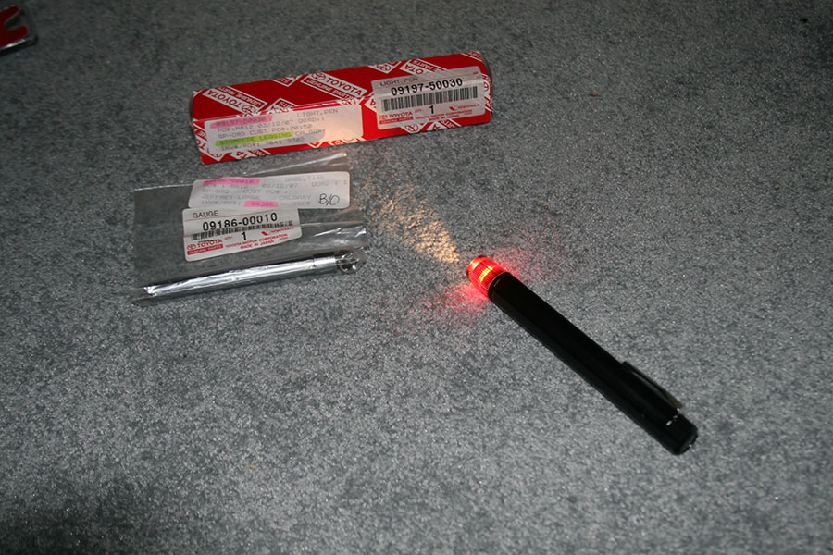
Including tire pressure gauge and flashlight

Slide 31
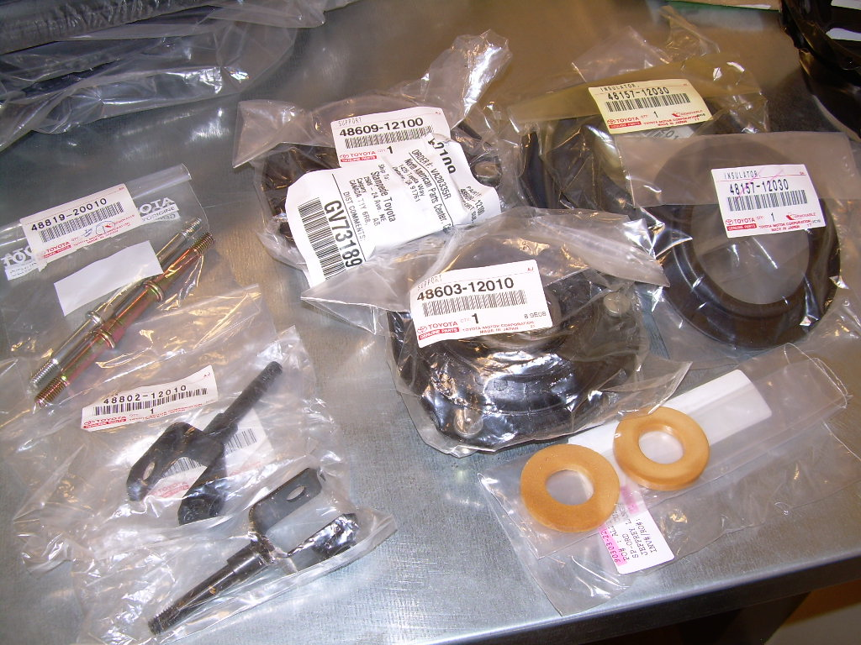
New suspension mounts and links

Slide 32
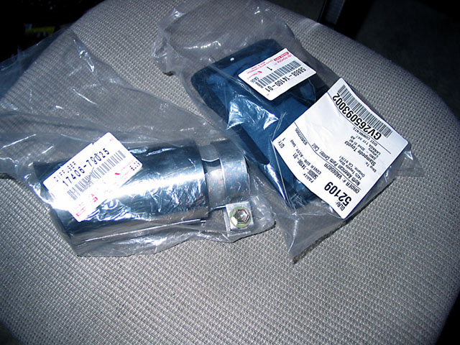
New factory exhaust tip and shift boot

Slide 33
Part Six
Changing Focus

Slide 34
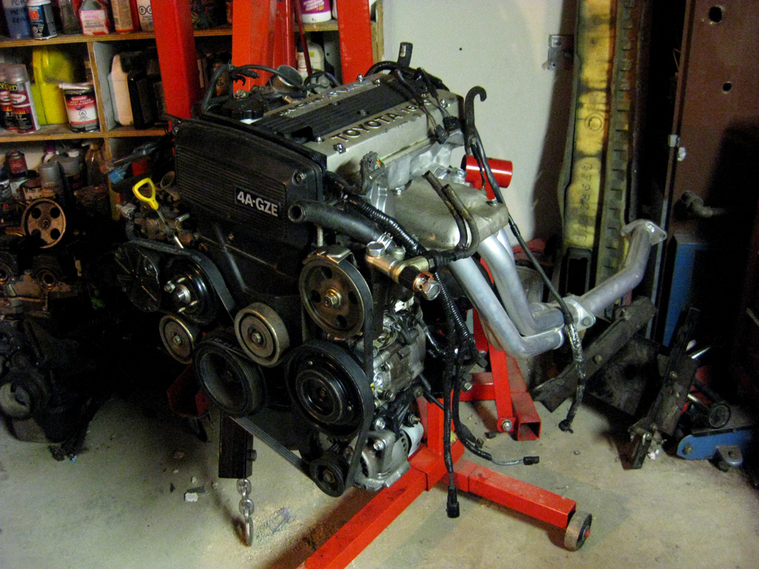
Rebuilt a supercharged engine

Slide 35
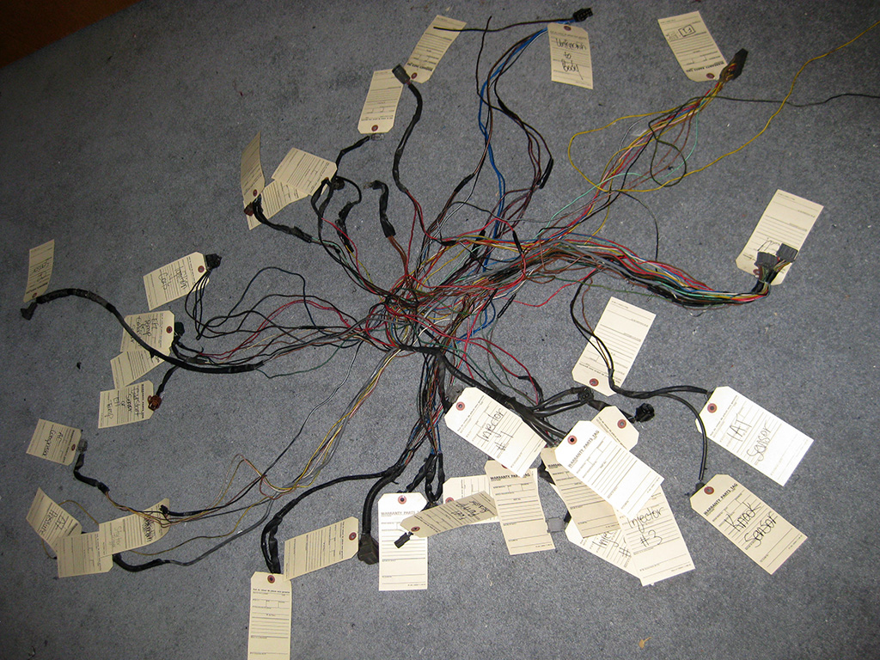
Converting/building engine wiring harness

Slide 36
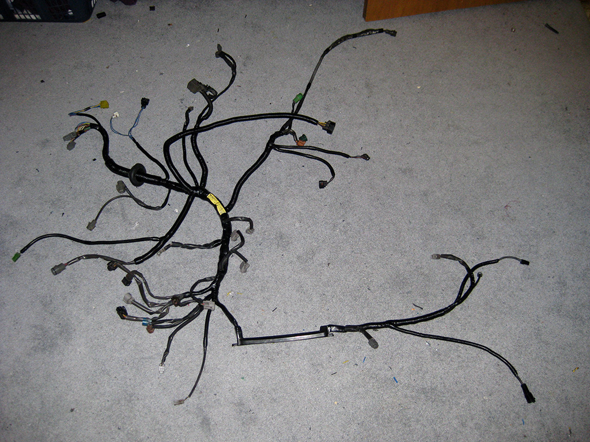
Completed engine wiring harness

Slide 37
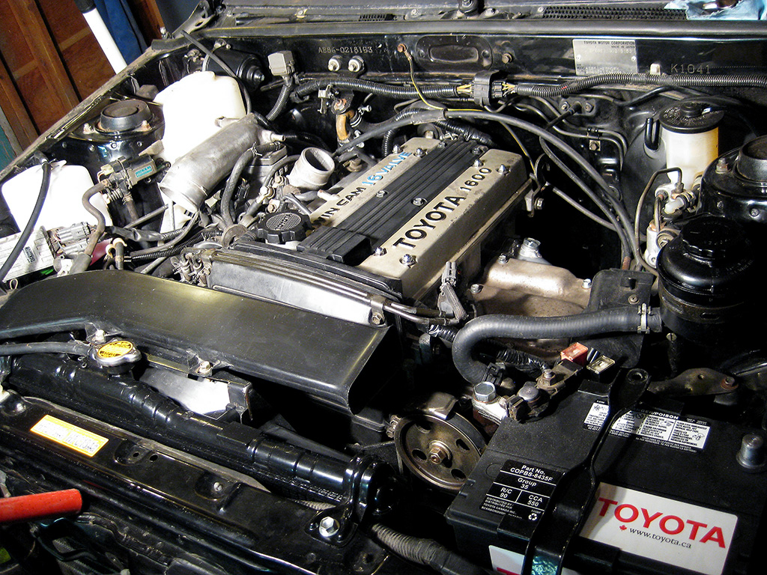
Supercharged engine installed

Slide 38
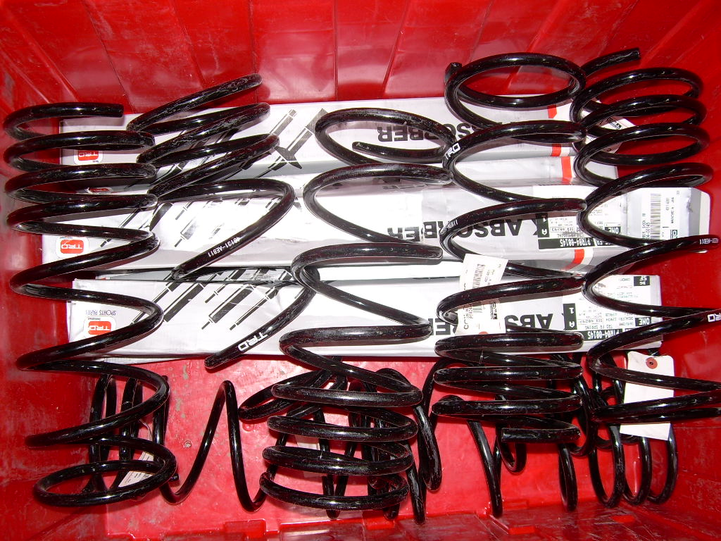
TRD Japan Street Springs and Shocks

Slide 39
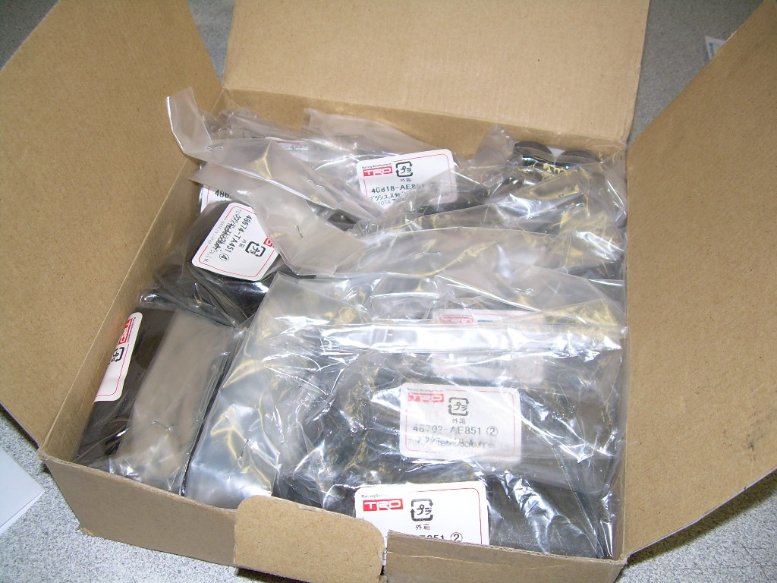
TRD Japan Suspension Bushing Set

Slide 40
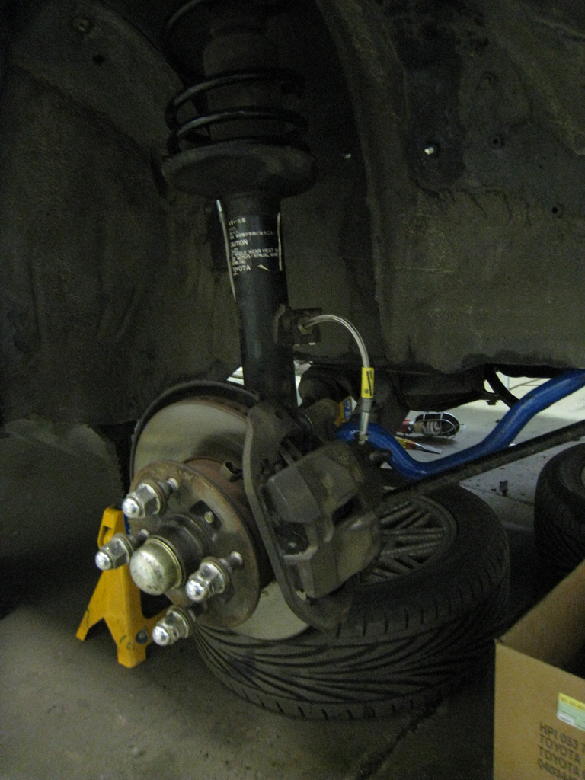
Installed brake and suspension upgrades

